Slide 1
Operating Systems

Slide 2
Unit I : Operating System - Introduction
Introduction
Structures-
Batch Processing
Multi programmed
Time-shared
Personal Computer
Parallel and Distributed Systems
Real-Time Systems and Network
System components
Operating System services
System Calls

Slide 3
INTRODUCTION
Operating System can be defined as an interface between user and the hardware. It provides an environment to the user so that, the user can perform its task in convenient and efficient way.
An operating system is a type of software without which we cannot operate or run a computer.
It acts as an intermediary between user and computer hardware.
An operating system is a well-organized collection of programs that manages the computer hardware.
It is a type of system software that is responsible for the smooth functioning of the computer system.

Slide 4
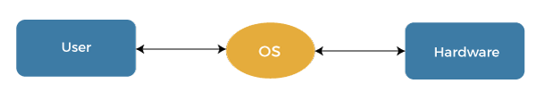

Slide 5
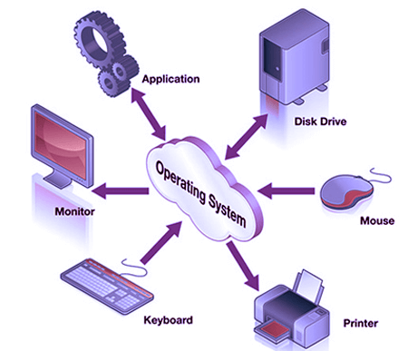
The operating system is a resource manager. It manages the hardware, including processors, memory, Input-Output devices, and communication devices.

Slide 6
Advantages of Operating System
It is helpful to monitor and regulate resources.
It can easily operate since it has a basic graphical user interface to communicate with your device.
It is used to create interaction between the users and the computer application or hardware.
The response time and throughput time of any process or program are fast.
It can share different resources like fax, printer, etc.

Slide 7
The following points indicate the need for the operating system:
More than one program runs at a time in a computer, and all of them require your computer's CPU and memory. The operating system manages resources for all those programs. That is why the operating system is required.
Multitasking is a very critical feature of the OS. With its help, we can run many programs simultaneously.
The operating system provides a platform to run any application program in the computer.

Slide 8
It helps the user in file management. Through this, the user can save the data according to his needs.
You use your mouse to open the application and click on the menu. All this is possible due to the modern operating system. This operating system allows you to do this with the help of GUI (Graphical user interface).
The operating system creates a communication link between the user and the computer hardware, allowing the user to run any application program and obtain the required output properly.
It is impossible for a user to use a computer system without an operating system.

Slide 9
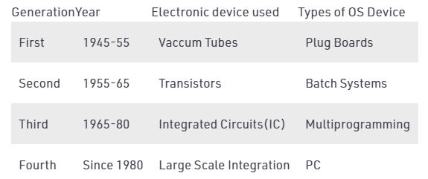
History of Operating system

Slide 10
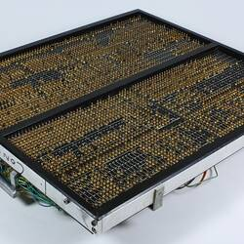
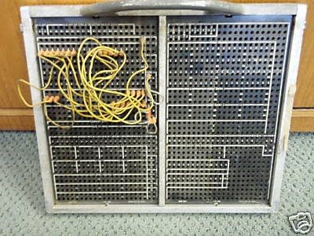
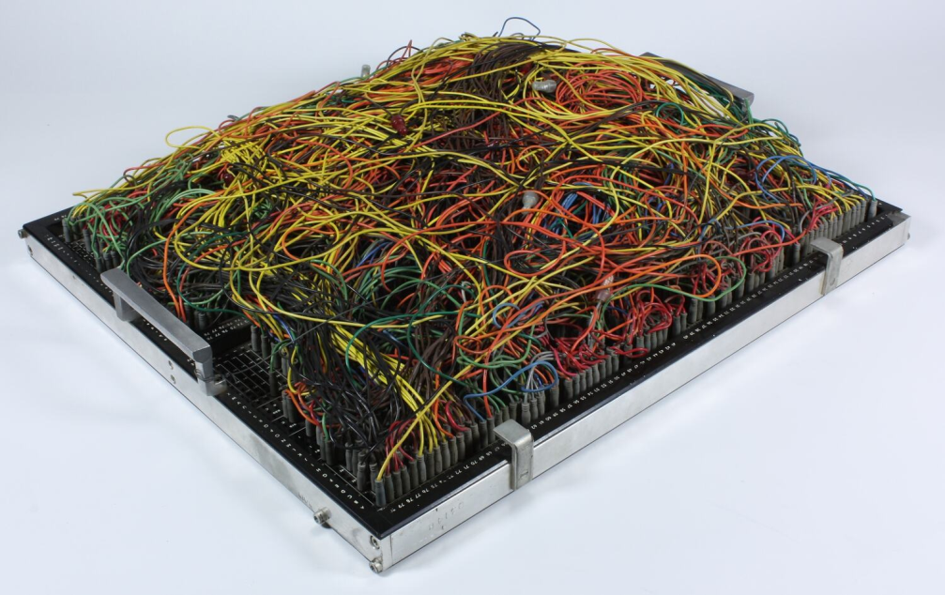
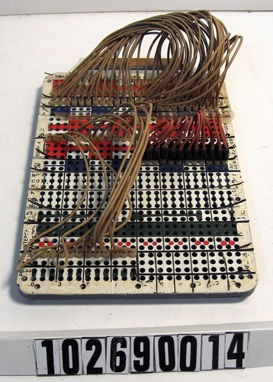

Slide 11
Generations of Operating System
The First Generation (1940 to early 1950s)
When the first electronic computer was developed in 1940, it was created without any operating system.
The Second Generation (1955 - 1965)- batch processor
The first operating system (OS) was created in the early 1950s and was known as GMOS.

Slide 12
The Third Generation (1965 - 1980) operating system designers were very capable of developing a new operating system that could simultaneously perform multiple tasks in a single computer program called multiprogramming.
The Fourth Generation (1980 - Present Day)
The fourth generation of operating systems is related to the development of the personal computer.
A major factor related to creating personal computers was the birth of Microsoft and the Windows operating system. Microsoft created the first window operating system in 1975.

Slide 13
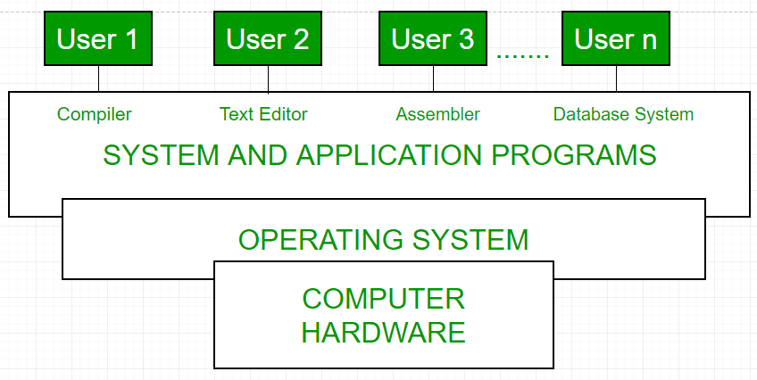
view of a operating system

Slide 14
What is Computer?
A computer is a programmable electronic device that accepts raw data as input and processes it with a set of instructions (a program) to produce the result as output. It can process numerical as well as non-numerical calculations.

Slide 15
What is a PC?
The PC is a general-purpose, cost-effective computer that stands for the personal computer. It is When Ed Roberts introduced the MITS Altair 8800, he coined the term PC. Alternatively, it is referred to as a single-user computer and a desktop that is designed to be used by a single end-user.
All PCs depend on the microprocessor technology that makes it capable for PC makers to set the whole CPU (central processing unit) on a single chip.

Slide 16
PC contains a keyboard, mouse, monitor, and system unit. Most of the personal computers have an Internet or a network connection, including ports for connecting peripheral devices like scanners, printers, digital cameras, and more.
Personal computers are used to create spreadsheets, write documents, play games, run databases, and many other tasks. Also, at home, it is widely used for playing PC games, multimedia entertainment, accessing the Internet and more.

Slide 17
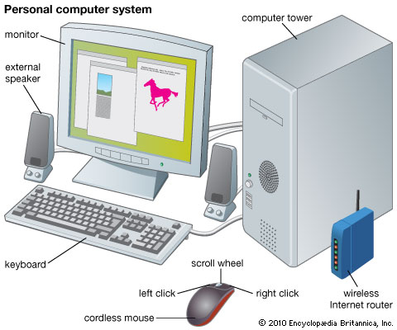
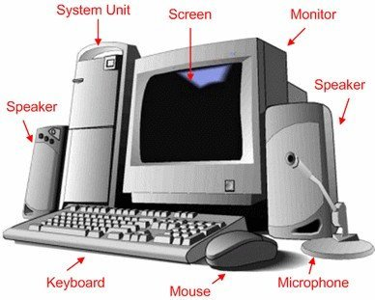
Personal computer operating system is made only for personal

Slide 18
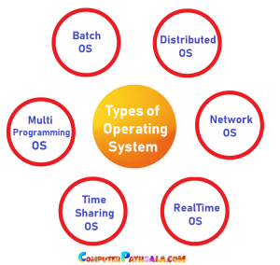

Slide 19
What is Batch Operating System?
Batch processing was very popular in the 1950S to 1970s.
The jobs were executed in batches. People used to have a single computer known as a mainframe.
Users using batch operating systems do not interact directly with the computer. Each user prepares their job using an offline device like a punch card and submitting it to the computer operator. Jobs with similar requirements are grouped and executed as a group to speed up processing. The output appeared after some time that could take days, hours, and minutes.

Slide 20
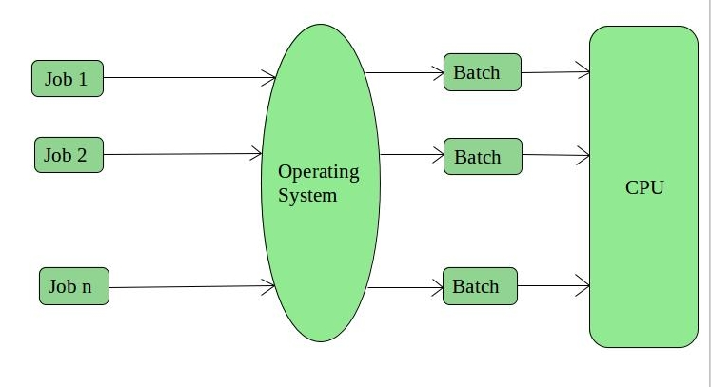
This type of operating system does not interact with the computer directly.
There is an operator which takes similar jobs having the same requirement and groups them into batches. It is the responsibility of the operator to sort jobs with similar needs.

Slide 21
Advantages:
The batch process can be divided into several stages to increase processing speed.
When a process is finished, the next job from the queue is run without any user interaction.
Disadvantages:
The computer operators should be well known with batch systems
Batch systems are hard to debug
It is sometimes costly
The other jobs will have to wait for an unknown time if any job fails

Slide 22
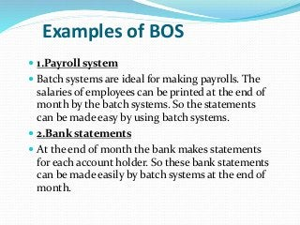
Examples of Batch-based Operating Systems: Payroll systems, Bank Statements, etc.

Slide 23
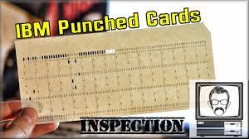
Punch cards

Slide 24
How does Batch Operating System work?
The operating system keeps the number of jobs in memory and performs them one at a time.
Jobs are processed in a first-come, first-served manner.
Each job set is defined as a batch.
When a task is finished, its memory is freed, and the work's output is transferred into an output spool for later printing or processing.

Slide 25
Time-Sharing Operating Systems
Each task is given some time to execute so that all the tasks work smoothly.
Each user gets the time of CPU as they use a single system.
These systems are also known as Multitasking Systems.
The task can be from a single user or different users also.
The time that each task gets to execute is called quantum. After this time interval is over OS switches over to the next task.
A time-sharing operating system allows several users to use a computer system simultaneously.

Slide 26
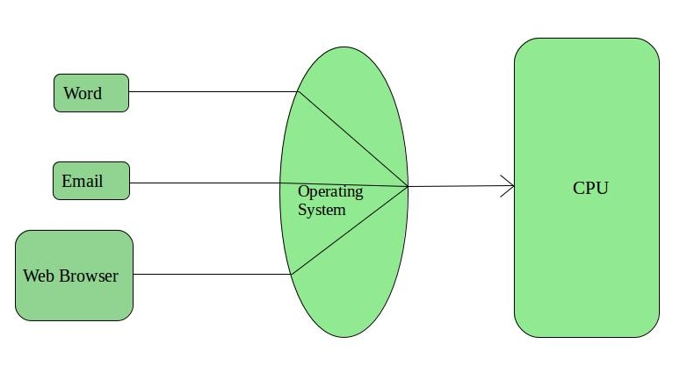
Time-sharing systems, use an interactive computer system to allow direct interaction between the user and the system. The term 'interactive' refers to the user's direct instructions to the system or program via an input device. The results will be shown on the output devices by the system.

Slide 27
Advantages
It helps to reduce the CPU idle time.
Each job gets an equal opportunity.
Examples of Time-Sharing OSs are: UNIX, Linux, Windows 2000 server.
Disadvantages
Data communication happens in the time-sharing operating system.
It has the problem of reliability.

Slide 28
Distributed operating systems
These types of the operating system is a recent advancement in the world of computer technology and are being widely accepted all over the world. Various computers communicate with each other using a shared communication network. Independent systems possess their own memory unit and CPU. These are referred to as loosely coupled systems or distributed operating systems.
The major benefit of working with these types of operating system is that it is always possible that one user can access the files or software which are not actually present on his system but some other system connected within this network.

Slide 29
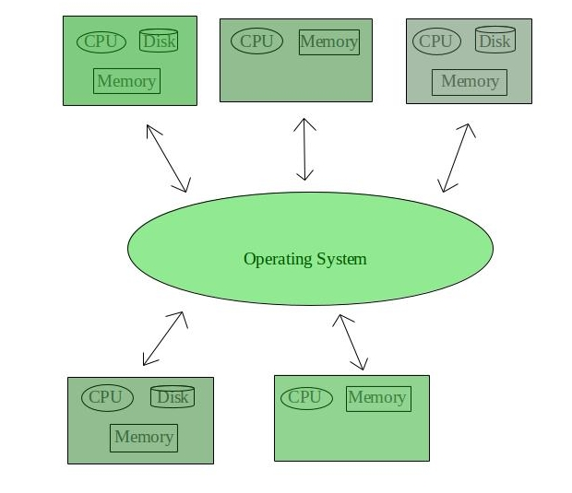

Slide 30
Advantages of Distributed Operating System
Failure of one will not affect the other, as all systems are independent of each other.
Electronic mail increases the data exchange speed.
Since resources are being shared, computation is highly fast.
Load on host computer reduces
Delay in data processing reduces
Examples: AIX operating system for IBM, Solaris operating system for SUN multiprocessor.

Slide 31
Disadvantages of Distributed Operating System
Failure of the main network will stop the entire communication.
These types of systems are not readily available as they are very expensive. Not only that, the underlying software is highly complex and not understood well yet

Slide 32
Parallel operating system
Parallel operating systems are a type of computer processing platform that breaks large tasks into smaller pieces that are done at the same time in different places and by different mechanisms. They are sometimes also described as “multi-core” processors. This type of system is usually very efficient at handling very large files and complex numerical codes. It’s most commonly seen in research locations where central server systems are handling a lot of different jobs at once but can be useful any time multiple computers are doing similar jobs and connecting to shared infrastructures simultaneously.
A parallel operating system works by dividing sets of calculations into smaller parts and distributing them between the machines on a network.

Slide 33
Advantages
It saves time, allowing the execution of applications in a shorter time.
Solve Larger Problems in a short point of time.
It is much better suited for modeling, simulating, and understanding complex, real-world problems.
We can do things simultaneously by using multiple resources.
Disadvantages
Power consumption is huge.
It is a bit difficult but with proper understanding and practice, you are good to go.

Slide 34
Network Operating System
These systems run on a server and provide the capability to manage data, users, security, applications, and other networking functions.
These types of operating systems allow shared access to files, printers, security, applications, and other networking functions over a small private network.
One more important aspect of Network Operating Systems is that all the users are well aware, of all other users within the network, their individual connections, etc. and that’s why these computers are popularly known as tightly coupled systems.

Slide 35
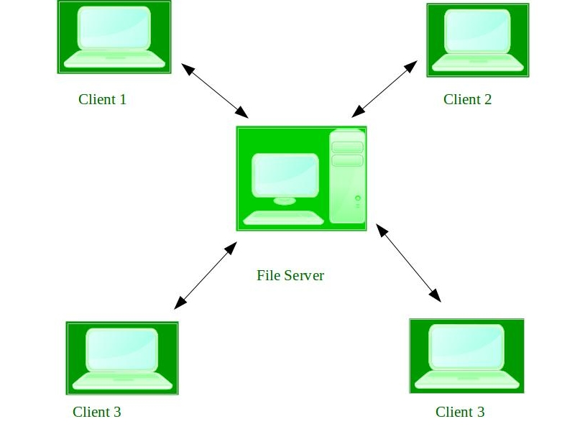

Slide 36
Advantages of Network Operating System:
Highly stable centralized servers
Security concerns are handled through servers
New technologies and hardware up-gradation are easily integrated into the system
Server access is possible remotely from different locations and types of systems
Examples of Network Operating systems are Microsoft Windows Server 2003, Microsoft Windows Server 2008, UNIX, Linux, Mac OS, etc.
Disadvantages of Network Operating System:
Servers are costly
User has to depend on a central location for most operations
Maintenance and updates are required regularly

Slide 37
Real-Time Operating System
Real-time systems are used when there are time requirements that are very strict like missile systems, air traffic control systems, robots, etc.
Types:
Hard Real-Time Systems: These OSs are meant for applications where time constraints are very strict and even the shortest possible delay is not acceptable. These systems are built for saving life like automatic parachutes or airbags which are required to be readily available in case of an accident. Virtual memory is rarely found in these systems.
Soft Real-Time Systems: These OSs are for applications where for time-constraint is less strict.

Slide 38
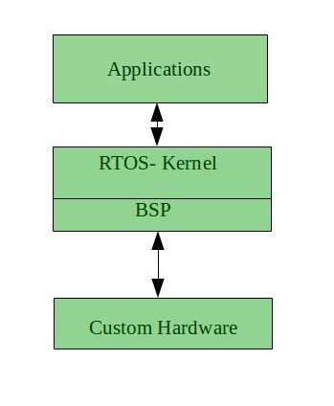
Examples of Real-Time Operating Systems are: Scientific experiments, medical imaging systems, industrial control systems, weapon systems, robots, air traffic control systems, etc.

Slide 39
Advantages of RTOS:
Maximum Consumption: Maximum utilization of devices and system, thus more output from all the resources
Task Shifting: The time assigned for shifting tasks in these systems are very less. For example, in older systems, it takes about 10 seconds in shifting one task to another, and in the latest systems, it takes 3 seconds.
Focus on Application: Focus on running applications and less importance on applications that are in the queue.
Real-time operating system in the embedded system: Since the size of programs is small, RTOS can also be used in embedded systems like in transport and etc.
Error Free: These types of systems are error-free.
Memory Allocation: Memory allocation is best managed in these types of systems.

Slide 40
Disadvantages of RTOS:
Limited Tasks: Very few tasks run at the same time and their concentration is very less on a few applications to avoid errors.
Use heavy system resources: Sometimes the system resources are not so good and they are expensive as well.
Complex Algorithms: The algorithms are very complex and difficult for the designer to write on.

Slide 41
Multi Programming OS
A multiprogramming OS, in which multiple programs can run simultaneously.
Multiprogramming is the allocation of more than one concurrent program on a computer system and its resources.
Multiprogramming allows using the CPU effectively by allowing various users to use the CPU and I/O devices effectively.
Multiprogramming makes sure that the CPU always has something to execute, thus increasing the CPU utilization.
multi programming is the ability of an os to execute multiple programs at the same time on single processor machine .one or more programs reside in the main memory which are ready to execute

Slide 42
Disadvantages
It is highly complicated.
The CPU scheduling is required.
Memory management is needed in the operating system because all types of tasks are stored in the main memory.
The harder task is to handle all processes and tasks.
Advantages
It may help to run various jobs in a single application simultaneously.
Various users may use the multiprogramming system at once.
Short-time jobs are done quickly in comparison to long-time jobs.
It helps in improving CPU utilization and never gets idle.
The resources are utilized smartly.

Slide 43
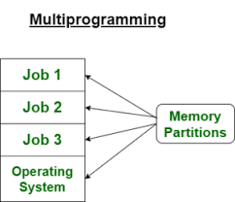
There are various examples of multiprogramming operating systems, including download apps, transfer data, MS-Excel, Google Chrome, Firefox browser, and many more apps.
Other examples are Windows O/S, UNIX O/S.

Slide 44
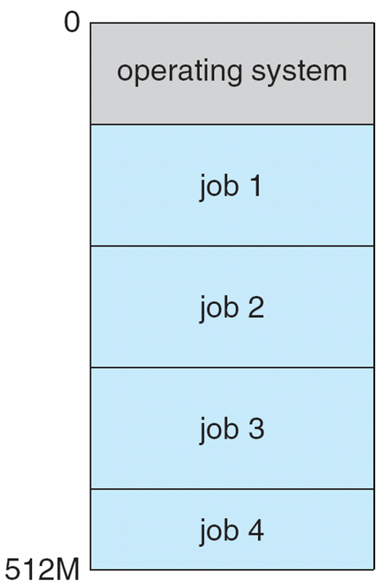
Operating system operations (modes):
In order to ensure the proper execution of the OS,
there must be a differentiate between the execution of
OS code and user-defined code.
There are two modes of execution:
User mode
Kernel mode(Supervisor mode, system mode, priviliged mode)
A mode bit is added to the computer hardware to
indicate the current mode: kernel(0), user(1)
The hardware allows privileged instructions to be executed only in kernel mode.

Slide 45
When the computer system is executing on behalf of a user application, the system is in user mode.
However, when a user application requests a service from the operating system (via a system call), it must transition from user to kernel mode to fulfill the request.
At system boot time, the hardware starts in kernel mode.
The operating system is then loaded and starts user applications in user mode.
Whenever a trap or interrupt occurs, the hardware switches from user mode to kernel mode (that is, changes the state of the mode bit to 0).
Thus, whenever the operating system gains control of the computer, it is in kernel mode.
The system always switches to user mode (by setting the mode bit to 1) before passing control to a user program.

Slide 46
User Mode vs Kernel Mode
User Mode is a restricted mode, which the application programs are executing and starts out. | Kernel Mode is the privileged mode, which the computer enters when accessing hardware resources.
Modes
User Mode is considered as the slave mode or the restricted mode. | Kernel mode is the system mode, master mode or the privileged mode.
Address Space
In User mode, a process gets their own address space. | In Kernel Mode, processes get single address space.
Interruptions
In User Mode, if an interrupt occurs, only one process fails. | In Kernel Mode, if an interrupt occurs, the whole operating system might fail.

Slide 47
User view, hardware view, system view
User View of Operating System: The Operating System is an interface, hides the details which must be performed and present a virtual machine to the user that makes it easier to use. Operating System provides the following services to the user.
Execution of a program
Access to I/O devices
Controlled access to files
Error detection (Hardware failures, and software errors)
System View of Operating System: Operating System is a program that functions in the same way as other programs. It is a set of instructions that are executed by the processor. Operating System acts as a program to perform the following.
Hardware upgrades
New services
Fixes the issues of resources
Controls the user and hardware operations

Slide 48
Hardware View of Operating System: The Operating System manages the resources efficiently in order to offer the services to the user programs. Operating System acts as a resource manager:
Allocation of resources
Controlling the execution of a program
Control the operations of I/O devices
Protection of resources
Monitors the data

Slide 49
Functions of Operating system (user)
Convenience: An OS makes a computer more convenient to use.
Efficiency: An OS allows the computer system resources to be used efficiently.
Ability to Evolve: An OS helps to develop, test, etc.

Slide 50
The Operating System functions :
Process Management
Memory Management
File Management
Input/Output Management
Device Management
Security
Scheduling
Interact with different software's

Slide 51
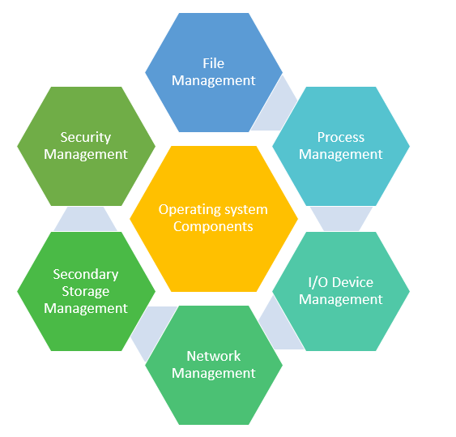
OS Components:

Slide 52
Process management involves various tasks like creation, scheduling, termination of processes, and a deadlock. Process is a program that is under execution, which is an important part of modern-day operating systems.
The operating system is responsible for the following activities in connection with process management:
→ Creating and deleting both user and system processes
→ Suspending and resuming processes
→ Providing mechanisms for process synchronization
→ Providing mechanisms for process communication
→ Providing mechanisms for deadlock handling

Slide 53
Memory management : The task of subdividing the memory among different processes is called memory management.
Memory management is a method in the operating system.
Keeping track of which parts of memory are currently being used and by whom
Deciding which processes (or parts thereof) and data to move into and out of memory
→Allocating and deallocating memory space as needed

Slide 54
A file management system is used for file maintenance (or management) operations. It is a type of software that manages data files in a computer system
→ Creating and deleting files and directories
→ Primitives to manipulate files and dirs
→ Mapping files onto secondary storage
→ Backup files onto stable (non-volatile) storage media

Slide 55
Security Management:
The security mechanisms in an operating system ensure that authorized programs have access to resources, and unauthorized programs have no access to restricted resources.
Security management refers to the various processes where the user changes the file, memory, CPU, and other hardware resources that should have authorization from the operating system.

Slide 56
Network Management :
Network management is a set of processes and procedures that help organizations to optimize their computer networks. Mainly, it ensures that users have the best possible experience while using network applications and services.
Network management is a fundamental concept of computer networks. Network Management Systems is a software application that provides network administrators with information on components in their networks. It ensures the quality of service and availability of network resources. It also examines the operations of a network, reconstructs its network configuration, modifies it for improving performance of tasks.

Slide 57
I/O Device Management
The I/O device management component is an I/O manager manages the main memory for devices using cache and spooling. This component provides a buffer cache and general device driver code that allows the system to manage the main memory and the hardware devices connected to it.
The purpose of the I/O system is to hide the details of hardware devices from the application programmer.
An I/O device management component allows highly efficient resource utilization while minimizing errors and making programming easy on the entire range of devices available in their systems.

Slide 58
Operating System Services:
Operating-system services that provides functions helpful to the user:
User interface
Program execution
I/O operations
File-system manipulation
Communications
Error detection
Time Sharing
OS functions for ensuring the efficient operation of the system:
Resource allocation
→ Protection and security

Slide 59
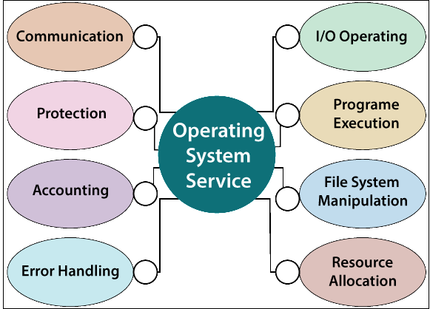

Slide 60
System Calls
System calls provide the interface between a running program and the operating system.
Types of System Calls:
→ Process control
→ File management
→ Device management
→ Information maintenance
→ Communications

Slide 61
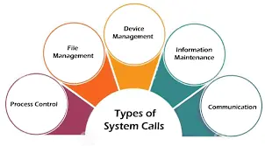
Process control is the system call that is used to direct the processes. Some process control examples include creating, load, abort, end, execute, process, terminate the process, etc.

Slide 62
File management is a system call that is used to handle the files. Some file management examples include creating files, delete files, open, close, read, write, etc.
Device management is a system call that is used to deal with devices. Some examples of device management include read, device, write, get device attributes, release device, etc.
Information maintenance is a system call that is used to maintain information. There are some examples of information maintenance, including getting system data, set time or date, get time or date, set system data, etc.
Communication is a system call that is used for communication. There are some examples of communication, including create, delete communication connections, send, receive messages, etc.

Slide 63
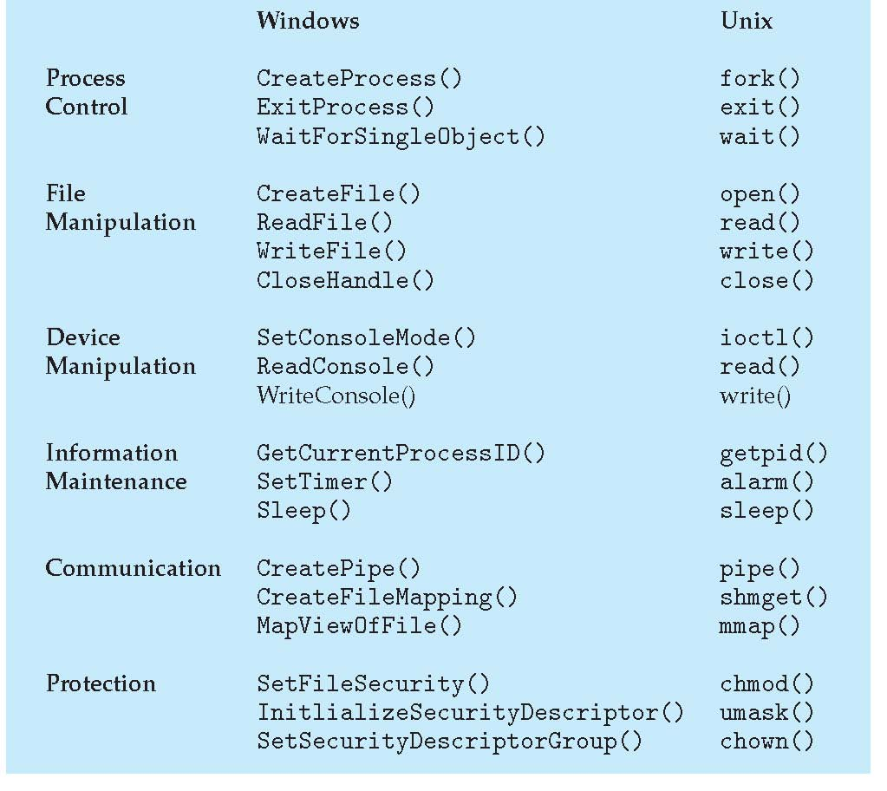
Examples of Windows and Unix System Calls

Slide 64
OS Structures:
A monolithic operating system is an OS architecture in which the entire operating system works in the kernel space. In contrast, a layered operating system is an OS architecture that is divided into a number of layers, each layer performing a specific functionality.
An operating system with different layers for handling system software and user software is known as a layered operating system.
Features | Monolithic | Layered Operating System
Definition | It is one in which the complete operating system operates in the kernel space. | A layered operating system that has divided into multiple layers, and each layer serves as a specific task.
Number of levels | There are mainly three layers in the monolithic operating system. | There are multiple layers in layered operating systems.

Slide 65
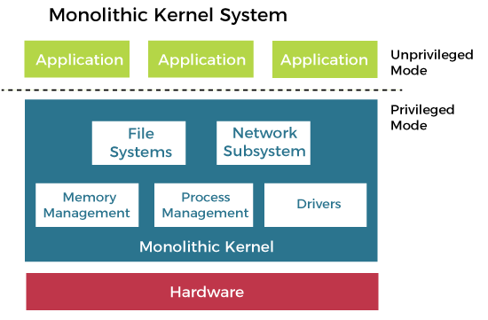
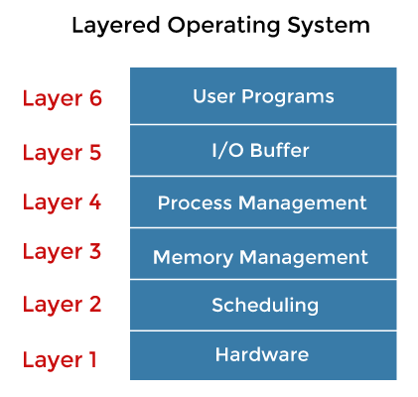

Slide 66
Monolithic Structure of Operating System:
The monolithic operating system is a very basic operating system in which file management, memory management, device management, and process management are directly controlled within the kernel.
The kernel can access all the resources present in the system. In monolithic systems, each component of the operating system is contained within the kernel.
The monolithic operating system is also known as the monolithic kernel. This is an old operating system used to perform small tasks like batch processing and time-sharing tasks in banks. The monolithic kernel acts as a virtual machine that controls all hardware parts.

Slide 67
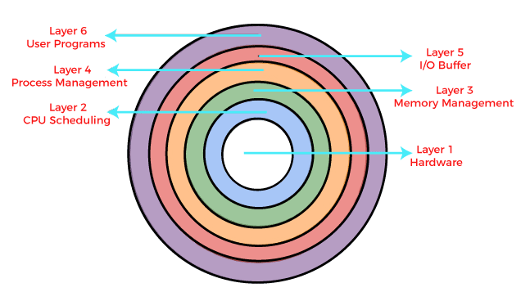
Layered Operating System
The layered structure approach breaks up the operating system into different layers and retains much more control on the system. The bottom layer (layer 0) is the hardware, and the topmost layer (layer N) is the user interface.

